Slide 1
Dijksra

Slide 2
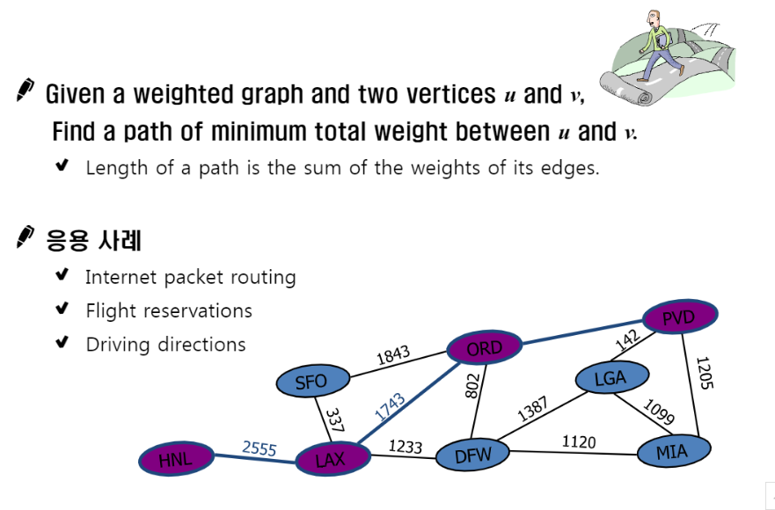
The shortest Path

Slide 3
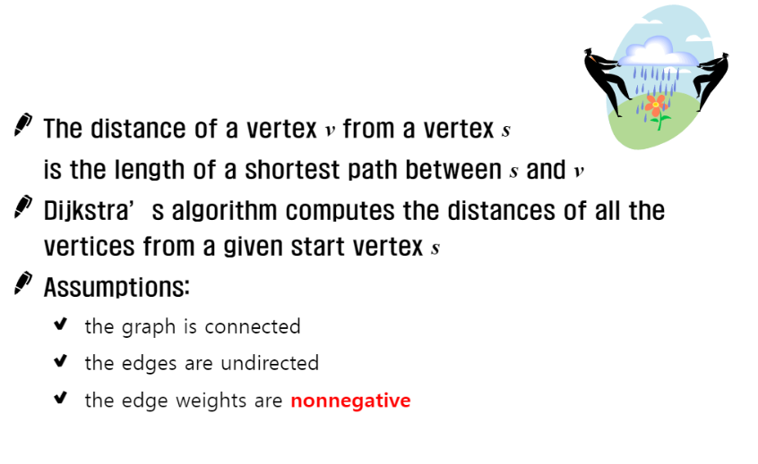
Dijkstra Algorithm

Slide 4
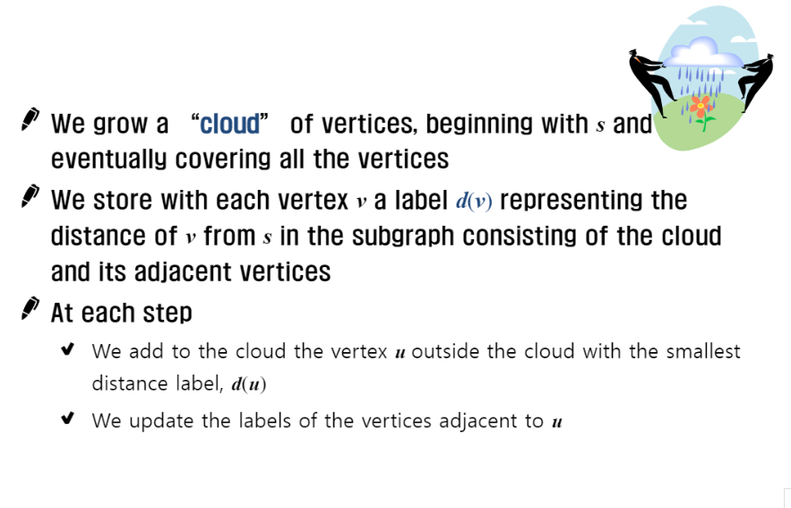
Dijkstra Algorithm

Slide 5
Dijkstra Algorithm
1 function Dijkstra(Graph, source):
2
3 create vertex set T
4
5 for each vertex v in Graph: // 초기화
6 Dist[v] ← INFINITY // 소스에서 v까지의 아직 모르는 길이
7 prev[v] ← UNDEFINED // 소스에서 최적 경로의 이전 꼭짓점
8 add v to T // 모든 노드는 초기에 Q에 속해있다 (미방문 집합)
9
10 Dist[source] ← 0 // 소스에서 소스까지의 길이
11
12 while T is not empty:
13 u ← vertex in T with min Dist[u] // 최소 거리를 갖는 꼭짓점
14 // 을 가장 먼저 선택한다
15 remove u from T
16
17 for each neighbor v of u: // v는 여전히 Q에 있다.
18 alt ← Dist[u] + length(u, v)
19 if alt < Dist[v]: // v 까지의 더 짧은 경로를 찾았을 때
20 Dist[v] ← alt
21 prev[v] ← u
22
23 return Dist[], prev[]

Slide 6
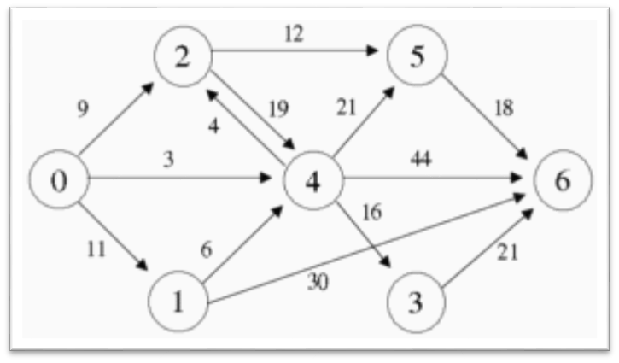
Dijkstra algorithm Example
T={1, 2, 3, ..., n};
S= 0
Dist[i]= MyMap[0][i];
while T is not empty:
v ← vertex in T with min Dist[u]
remove v from T
for each neighbor v of w:
      Dist[w]=MIN(Dist[w], Dist[v]+ MyMap[v][w])
MyMap[ ][ ]:
 | 0 | 1 | 2 | 3 | 4 | 5 | 6
0 | 0 | 11 | 9 | ∞ | 3 | ∞ | ∞
1 | ∞ | 0 | ∞ | ∞ | 6 | ∞ | 30
2 | ∞ | ∞ | 0 | ∞ | 19 | 12 | ∞
3 | ∞ | ∞ | ∞ | 0 | ∞ | ∞ | 21
4 | ∞ | ∞ | 4 | 16 | 0 | 21 | 44
5 | ∞ | ∞ | ∞ | ∞ | ∞ | 0 | 18
6 | ∞ | ∞ | ∞ | ∞ | ∞ | ∞ | 0

Slide 7
Dijkstra algorithm Example
T={1, 2, 3, ..., n};
S= 0
Dist[i]= MyMap[0][i];
while T is not empty:
v ← vertex in T with min Dist[u]
remove v from T
for each neighbor v of w:
      Dist[w]=MIN(Dist[w], Dist[v]+ MyMap[v][w])
S = {0} T = {1, 2, 3, 4, 5, 6}
7
Dist[]: | 11 | 9 | ∞ | 3 | ∞ | ∞
 | 1 | 2 | 3 | 4 | 5 | 6
19
24
47
v = 4
#1
IsDone = {0, 4} T = {1, 2, 3, 5, 6}
Dist[1]: 11 <Dist[4] + MyMap[4][1] = 3+∞ = ∞
Dist[2]: 9 <Dist[4] + MyMap[4][2] = 3+4 = 7
Dist[3]: ∞ <Dist[4] + MyMap[4][3] = 3+16 = 19
Dist[5]: ∞ <Dist[4] + MyMap[4][5] = 3+21 = 24
Dist[6]: ∞ <Dist[4] + MyMap[4][6] = 3+44 = 47

Slide 8
Dijkstra algorithm Example
T={1, 2, 3, ..., n};
S= 0
Dist[i]= MyMap[0][i];
while T is not empty:
v ← vertex in T with min Dist[u]
remove v from T
for each neighbor v of w:
      Dist[w]=MIN(Dist[w], Dist[v]+ MyMap[v][w])
S = {0} T = {1, 2, 3, 4, 5, 6}
Dist[]: | 11 | 7 | 19 | 3 | 24 | 47
 | 1 | 2 | 3 | 4 | 5 | 6
19
v = 2
#1
IsDone = {0, 2, 4} T = {1, 3, 5, 6}
Dist[1]: 11 <Dist[2] + MyMap[2][1] = 7+∞ = ∞
Dist[3]: 19 <Dist[2] + MyMap[2][3] = 7+∞ = ∞
Dist[5]: 24 <Dist[2] + MyMap[2][5] = 7+12 = 19
Dist[6]: 47 <Dist[2] + MyMap[2][6] = 7+∞ = ∞

Slide 9
Dijkstra algorithm Example
T={1, 2, 3, ..., n};
S= 0
Dist[i]= MyMap[0][i];
while T is not empty:
v ← vertex in T with min Dist[u]
remove v from T
for each neighbor v of w:
      Dist[w]=MIN(Dist[w], Dist[v]+ MyMap[v][w])
S = {0} T = {1, 2, 3, 4, 5, 6}
Dist[]: | 11 | 7 | 19 | 3 | 19 | 47
 | 1 | 2 | 3 | 4 | 5 | 6
41
v = 1
#1
IsDone = {0, 1, 2, 4} T = { 3, 5, 6}
Dist[3]: 19 <Dist[1] + MyMap[1][3] = 11+∞ = ∞
Dist[5]: 19 <Dist[1] + MyMap[1][5] = 11+∞ = ∞
Dist[6]: 47 <Dist[1] + MyMap[1][6] = 11+30 =41

Slide 10
Dijkstra algorithm Example
T={1, 2, 3, ..., n};
S= 0
Dist[i]= MyMap[0][i];
while T is not empty:
v ← vertex in T with min Dist[u]
remove v from T
for each neighbor v of w:
      Dist[w]=MIN(Dist[w], Dist[v]+ MyMap[v][w])
S = {0} T = {1, 2, 3, 4, 5, 6}
Dist[]: | 11 | 7 | 19 | 3 | 19 | 41
 | 1 | 2 | 3 | 4 | 5 | 6
40
v = 3
#1
IsDone = {0, 1, 2, 3, 4} T = { 5, 6}
Dist[5]: 19 <Dist[3] + MyMap[3][5] = 19+∞ = ∞
Dist[6]: 47 <Dist[3] + MyMap[3][6] = 19+21 =40

Slide 11
Dijkstra algorithm Example
T={1, 2, 3, ..., n};
S= 0
Dist[i]= MyMap[0][i];
while T is not empty:
v ← vertex in T with min Dist[u]
remove v from T
for each neighbor v of w:
      Dist[w]=MIN(Dist[w], Dist[v]+ MyMap[v][w])
S = {0} T = {1, 2, 3, 4, 5, 6}
Dist[]: | 11 | 7 | 19 | 3 | 19 | 40
 | 1 | 2 | 3 | 4 | 5 | 6
v = 5
#1
IsDone = {0, 1, 2, 3, 4, 5} T = { 6}
Dist[6]: 47 <Dist[5] + MyMap[5][6] = 19+21 =40

Slide 12
Dijkstra algorithm Example
T={1, 2, 3, ..., n};
S= 0
Dist[i]= MyMap[0][i];
while T is not empty:
v ← vertex in T with min Dist[u]
remove v from T
for each neighbor v of w:
      Dist[w]=MIN(Dist[w], Dist[v]+ MyMap[v][w])
S = {0} T = {1, 2, 3, 4, 5, 6}
Dist[]: | 11 | 7 | 19 | 3 | 19 | 40
 | 1 | 2 | 3 | 4 | 5 | 6
v = 6
#1
IsDone = {0, 1, 2, 3, 4, 5, 6} T = { }

Slide 13
Floyd warshall

Slide 14
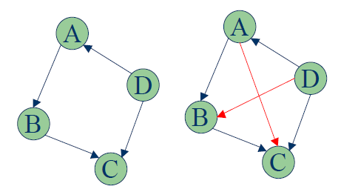
Transitive closure
(이행적: a와 b가 집합이고, b와 c가 집합 일 시 , a와 c가 집합)
A → C에 직접 경로가 없지만, 우회경로(B)가 있을 시
  A → C로 연결

Slide 15
WarShall Algorithm
WarShall Algorithm
procedure Warshall (M_{R} : n*n 0/1 행렬)
P := M_{R};
for k:=1 to n
begin
for i:=1 to n
begin
for j:= 1 to n
P_{ij}=P_{ij} ∨(P_{ik} ∧P_{kj})
end
end

Slide 16
Warshall Example
Warshall Example
  P Adjacent Matrix
1 | 2 | 3 | 4
구미
일산
구미 1
일산 2
서울3
대구 4
0 | 1 | 0 | 0
1 | 0 | 1 | 0
0 | 0 | 0 | 1
1 | 0 | 0 | 0
대구
서울

Slide 17
Warshall Example
Warshall Example
  via = 1
    P₄₄(1)=P₄₄ (0) ∨(P₄₁(0)∧P₁₄(0)) = 0 ∨ 1 = 1
1 | 2 | 3 | 4
구미
일산
구미 1
일산 2
서울3
대구 4
0 | 1 | 0 | 0
1 | 1 | 1 | 0
0 | 0 | 0 | 1
1 | 1 | 0 | 0
대구
서울

Slide 18
Warshall Example
Warshall Example
  via = 2
    P₃₃(2)=P₃₃ (1) ∨(P₃₂(1)∧P2₂₃(1)) = 0 ∨ 1 = 1
1 | 2 | 3 | 4
구미
일산
구미 1
일산 2
서울3
대구 4
1 | 1 | 1 | 0
1 | 1 | 1 | 0
0 | 0 | 0 | 1
1 | 1 | 1 | 0
대구
서울

Slide 19
Warshall Example
Warshall Example
  via = 3
    P₂₄(3)=P₂₄ (2) ∨(P₂₃(2)∧P₃₄(2)) = 0 ∨ 1 = 1
1 | 2 | 3 | 4
구미
일산
구미 1
일산 2
서울3
대구 4
1 | 1 | 1 | 1
1 | 1 | 1 | 1
0 | 0 | 0 | 1
1 | 1 | 1 | 1
대구
서울

Slide 20
Warshall Example
Warshall Example
  via = 4
    P₂₁(4)=P₂₁ (3) ∨(P₂₄(3)∧P₄₁(3)) = 0 ∨ 1 = 1
1 | 2 | 3 | 4
구미
일산
구미 1
일산 2
서울3
대구 4
1 | 1 | 1 | 1
1 | 1 | 1 | 1
1 | 1 | 1 | 1
1 | 1 | 1 | 1
대구
서울

Slide 21
AllPairsShortest
APS (Algorithm Problem Solving)
1
4
2
D | 1 | 2 | 3 | 4 | 5
1 | 0 | 4 | 2 | 5 | ∞
2 | ∞ | 0 | 1 | ∞ | 4
3 | 1 | 3 | 0 | 1 | 2
4 | -2 | ∞ | ∞ | 0 | 2
5 | ∞ | -3 | 3 | 1 | 0
2
3
1
3
1
5
-2
4
-3
2
1
3
4
1
5
2
for via in range(howmany):
for start in range(howmany): #단, start!=via
for stop in range(howmany): #단, start!=stop, stop!=via
if D[start][stop] > D[start][via] + D[via][stop]:
D[start][stop] = D[start][via] + D[via][stop]:

Slide 22

APS (Algorithm Problem Solving)
via=1
1
4
2
D | 1 | 2 | 3 | 4 | 5
1 | 0 | 4 | 2 | 5 | ∞
2 | ∞ | 0 | 1 | ∞ | 4
3 | 1 | 3 | 0 | 1 | 2
4 | -2 | 2 | 0 | 0 | 2
5 | ∞ | -3 | 3 | 1 | 0
2
3
1
3
1
5
-2
4
-3
2
1
3
4
1
5
2

Slide 23

APS (Algorithm Problem Solving)
via=1
  D[2,3] = min{D[2,3], D[2,1]+D[1,3]} = min{1, ∞+2} = 1
  D[2,4] = min{D[2,4], D[2,1]+D[1,4]} = min{∞, ∞+5} = ∞
  D[2,5] = min{D[2,5], D[2,1]+D[1,5]} = min{4, ∞+∞} = 4
  D[3,2] = min{D[3,2], D[3,1]+D[1,2]} = min{3, 1+4} = 3
  D[3,4] = min{D[3,4], D[3,1]+D[1,4]} = min{1, 1+5} = 1
  D[3,5] = min{D[3,5], D[3,1]+D[1,5]} = min{2, 1+∞} = 2
  D[4,2] = min{D[4,2], D[4,1]+D[1,2]} = min{∞, -2+4} = 2
  D[4,3] = min{D[4,3], D[4,1]+D[1,3]} = min{∞, -2+2} = 0
  D[4,5] = min{D[4,5], D[4,1]+D[1,5]} = min{2, -2+∞} = 2
  D[5,2] = min{D[5,2], D[5,1]+D[1,2]} = min{-3, ∞+4} = -3
  D[5,3] = min{D[5,3], D[5,1]+D[1,3]} = min{3, ∞+2} = 3
  D[5,4] = min{D[5,4], D[5,1]+D[1,4]} = min{1, ∞+5} = 1

Slide 24
APS (Algorithm Problem Solving)
via=2
1
4
2
D | 1 | 2 | 3 | 4 | 5
1 | 0 | 4 | 2 | 5 | 8
2 | ∞ | 0 | 1 | ∞ | 4
3 | 1 | 3 | 0 | 1 | 2
4 | -2 | 2 | 0 | 0 | 2
5 | ∞ | -3 | -2 | 1 | 0
2
3
1
3
1
5
-2
4
-3
2
1
3
4
1
5
2

Slide 25
APS (Algorithm Problem Solving)
via=3
via=4
D | 1 | 2 | 3 | 4 | 5
1 | 0 | 4 | 2 | 3 | 4
2 | 2 | 0 | 1 | 2 | 3
3 | 1 | 3 | 0 | 1 | 2
4 | -2 | 2 | 0 | 0 | 2
5 | -1 | -3 | -2 | -1 | 0
1
4
2
2
3
1
3
1
5
-2
4
-3
2
D | 1 | 2 | 3 | 4 | 5
1 | 0 | 4 | 2 | 3 | 4
2 | 0 | 0 | 1 | 2 | 3
3 | -1 | 3 | 0 | 1 | 2
4 | -2 | 2 | 0 | 0 | 2
5 | -3 | -3 | -2 | -1 | 0
1
3
4
1
5
2

Slide 26
APS (Algorithm Problem Solving)
via=5.
D | 1 | 2 | 3 | 4 | 5
1 | 0 | 1 | 2 | 3 | 4
2 | 0 | 0 | 1 | 2 | 3
3 | -1 | -1 | 0 | 1 | 2
4 | -2 | -1 | 0 | 0 | 2
5 | -3 | -3 | -2 | -1 | 0
1
4
2
2
3
1
3
1
5
-2
4
-3
2
1
3
4
1
5
2

Slide 27
웜 바이러스(백준 2606)
Floyd warshall, Disjoint Set 이용해서 풀어보기

